Slide 1


Software Engineering
Notes:
NOTE:
To change the image on this slide, select the picture and delete it. Then click the Pictures icon in the placeholder to insert your own image.

Slide 2


Slide 3
Ambiguous Requirements
The system should be easy to use by medical staff and should be organized in such a way that user errors are minimized.
Allows user to cancel sales orders.
The system provides searching of data quickly.
“The system is user friendly.”

Slide 4
Ambiguous Requirements
“Software produces a print normally in ten seconds.”
The staff shall be able to use all the system functionalities. The average number of errors made by users shall not exceed two per hour of system use.

Slide 5
Characteristics of Good Requirements
Numbered
Inspected
Unambiguous
Testable
Complete
Consistent
Understandable
Traceable
Feasible
Modifiable

Slide 6

Task - 2
Write down five functional requirements and five non-functional requirements of an online examination system.

Slide 7
Quality Factors
Portability
Reusability
Interoperability
Survivability
Safety
Manageability
Supportability
Replaceability
Functionality
Correctness
Reliability
Efficiency
Usability
Integrity
Maintainability
Flexibility
Testability
Security

Slide 8
The Problems with our Requirements Practices
We have trouble understanding the requirements that we do acquire from the customer
We often record requirements in a disorganized manner
We spend far too little time verifying what we do record
We allow change to control us, rather than establishing mechanisms to control change
Most importantly, we fail to establish a solid foundation for the system or software that the user wants built

Slide 9
Requirements Engineering Tasks
Seven distinct tasks
Inception
Elicitation
Elaboration
Negotiation
Specification
Validation
Requirements Management
Some of these tasks may occur in parallel and all are adapted to the needs of the project
All strive to define what the customer wants
All serve to establish a solid foundation for the design and construction of the software

Slide 10
Inception
Elicitation
Elaboration
Negotiation
Specification
Validation
Requirements
Management

Slide 11
Inception Task
During inception, the requirements engineer asks a set of questions to establish…
A basic understanding of the problem
The people who want a solution
The nature of the solution that is desired
The effectiveness of preliminary communication and collaboration between the customer and the developer
Through these questions, the requirements engineer needs to…
Identify the stakeholders
Recognize multiple viewpoints
Work toward collaboration
Break the ice and initiate the communication

Slide 12
The First Set of Questions
These questions focus on the customer, other stakeholders, the overall goals, and the benefits
Who is behind the request for this work?
Who will use the solution?
What will be the economic benefit of a successful solution?
Is there another source for the solution that you need?

Slide 13
The Next Set of Questions
These questions enable the requirements engineer to gain a better understanding of the problem and allow the customer to voice his or her perceptions about a solution
How would you characterize "good" output that would be generated by a successful solution?
What problem(s) will this solution address?
Can you show me (or describe) the business environment in which the solution will be used?
Will special performance issues or constraints affect the way the solution is approached?

Slide 14
The Final Set of Questions
These questions focus on the effectiveness of the communication activity itself
Are you the right person to answer these questions? Are your answers "official"?
Are my questions relevant to the problem that you have?
Am I asking too many questions?
Can anyone else provide additional information?
Should I be asking you anything else?

Slide 15
Inception
Elicitation
Elaboration
Negotiation
Specification
Validation
Requirements
Management

Slide 16
Elicitation Task
Eliciting requirements is difficult because of
Problems of scope in identifying the boundaries of the system or specifying too much technical detail rather than overall system objectives
Problems of understanding what is wanted, what the problem domain is, and what the computing environment can handle (Information that is believed to be "obvious" is often omitted)
Problems of volatility because the requirements change over time
Elicitation may be accomplished through two activities
Collaborative requirements gathering
Quality function deployment

Slide 17
Basic Guidelines of Collaborative Requirements Gathering
Meetings are conducted and attended by both software engineers, customers, and other interested stakeholders
Rules for preparation and participation are established
An agenda is suggested that is formal enough to cover all important points but informal enough to encourage the free flow of ideas
A "facilitator" (customer, developer, or outsider) controls the meeting
A "definition mechanism" is used such as work sheets, flip charts, wall stickers, electronic bulletin board, chat room, or some other virtual forum
The goal is to identify the problem, propose elements of the solution, negotiate different approaches, and specify a preliminary set of solution requirements

Slide 18
Quality Function Deployment
This is a technique that translates the needs of the customer into technical requirements for software
It emphasizes on understanding of what is valuable to the customer and then deploys these values throughout the engineering process through functions, information, and tasks
It identifies three types of requirements
Normal requirements: These requirements are the objectives and goals stated for a product or system during meetings with the customer
Expected requirements: These requirements are implicit to the product or system and may be so fundamental that the customer does not explicitly state them
Exciting requirements: These requirements are for features that go beyond the customer's expectations and prove to be very satisfying when present

Slide 19
QFD process (1)
The basic idea of QFD is to construct relationship matrices between customer needs, technical requirements, priorities and (if needed) competitor assessment.
To achieve this the following process is prescribed:
Identify stakeholder’s attributes or requirements
Identify technical features of the requirements
Relate the requirements to the technical features
Conduct an evaluation of competing products
Evaluate technical features and specify a target value for each feature
Prioritize technical features for development effort.

Slide 20
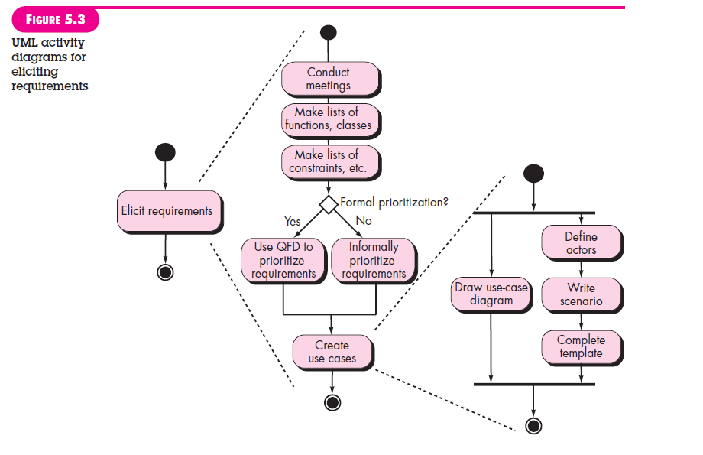

Slide 21
Inception
Elicitation
Elaboration
Negotiation
Specification
Validation
Requirements
Management

Slide 22
Goals of Analysis Modeling
Provides the first technical representation of a system
Is easy to understand and maintain
Deals with the problem of size by partitioning the system
Uses graphics whenever possible
Differentiates between essential information versus implementation information
Helps in the tracking and evaluation of interfaces
Provides tools other than narrative text to describe software logic and policy

Slide 23
Analysis Rules of Thumb
The analysis model should focus on requirements that are visible within the problem or business domain
The level of abstraction should be relatively high
Each element of the analysis model should add to an overall understanding of software requirements and provide insight into the following
Information domain, function, and behavior of the system
The model should provide value to all stakeholders
The model should be kept as simple as can be
Our concern about what we will implement
Not worried about that how we will implement

Slide 24
Analysis Modeling Approaches
Structured analysis
Considers data and the processes that transform the data as separate entities
Data is modeled in terms of only attributes and relationships (but no operations)
Processes are modeled to show the 1) input data, 2) the transformation that occurs on that data, and 3) the resulting output data
Object-oriented analysis
Focuses on the definition of classes and the manner in which they collaborate with one another to fulfill customer requirements

Slide 25
Elements of the Analysis Model
Object-oriented Analysis
Structured Analysis
Scenario-based
modeling
Flow-oriented
modeling
Use case text
Use case diagrams
Activity diagrams
Swim lane diagrams
Data structure diagrams
Data flow diagrams
Control-flow diagrams
Processing narratives
Class-based
modeling
Behavioral
modeling
Class diagrams
Analysis packages
CRC models
Collaboration diagrams
State diagrams
Sequence diagrams

Slide 26
CRC Card

Slide 27
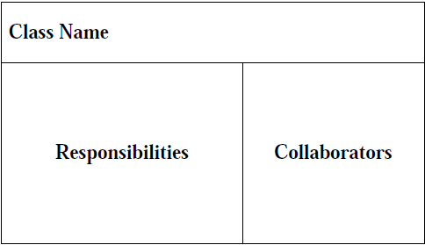
CRC Cards
A CRC card is divided into three sections (Beck & Cunningham, 1989; Ambler, 1995)

Slide 28
Responsibilities and Collaborations
A responsibility is anything that a class knows or does.
Sometimes a class will have a responsibility to fulfill, but will not have enough information to do it. When this happens it has to collaborate with other classes to get the job done.

Slide 29
CRC Model
A CRC model is a collection of CRC cards that represent whole or part of an application or problem domain.
The most common use for CRC models is to gather and define the user requirements for an object-oriented application.
Collaborating cards are placed close to each other

Slide 30
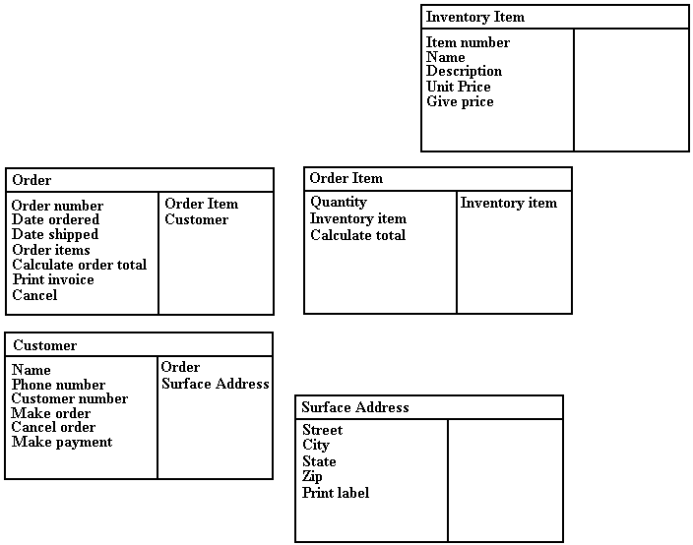

Slide 31
Creating CRC Model
Put together the CRC modeling team.
Organize the modeling room.
Do some brainstorming.
Explain the CRC modeling technique.
Iteratively perform the steps of CRC modeling.
Perform use-case scenario testing.

Slide 32
CRC Team
Business Domain Experts (BDEs).
Facilitator.
Scribe(s).
Observers.

Slide 33
Room preparation
Reserve a meeting room that has something write on.
Bring CRC modeling supplies.
Have a modeling table
Have chairs and desks for the scribe(s).
Have chairs for the BDEs.
Have chairs for the observers

Slide 34
Brainstorming
Set of questions:
Who is this system for?
What will they do with the system?
Why do we do this?
Why do we do this the way that we do?
What business needs does this system support?
What do/will our customers want/demand from us?
How is the business changing?
What is our competition doing? Why? How can we do it better?
Do we even need to do this?
If we were starting from scratch, how would we do this?
Just because we were successful in the past doing this, will we be successful in the future?

Slide 35
Brainstorming (cont…)
Can we combine several jobs into one? Do we want to?
How will people’s jobs be affected? Are we empowering or disempowering them?
What information will people need to do their jobs?
Is work being performed where it makes the most sense?
Are there any trivial tasks that we can automate?
Are people performing only the complex tasks that the system can’t handle?
Will the system pay for itself?
Does the system support teamwork, or does it hinder it?
Do our users have the skills/education necessary to use this system? What training will they need?
What are our organization’s strategic goals and objectives? Does this system support them?
How can we do this faster?
How can we do this cheaper?
How can we do this better?

Slide 36
Explain the CRC Modeling Technique
Facilitator should describe the CRC modeling process. This usually takes between ten and fifteen minutes and will often include the creation of several example CRC cards.
Lead BDEs through creation of example CRC cards

Slide 37
Perform The Iterative Steps of CRC Modeling
Find classes
Look for anything that interacts with the system, or is part of the system
Ask yourself “Is there a customer?”
Follow the money
Look for reports generated by the system
Look for any screens used in the system
Immediately prototype interface and report classes
Look for the three to five main classes right away
Create a new card for a class immediately
Use one or two words to describe the class
Class names are singular

Slide 38
Find responsibilities
Ask yourself what the class knows
Ask yourself what the class does
If you’ve identified a responsibility, ask yourself what class it "belongs" to
Sometimes get responsibilities that we won’t implement, and that’s OK
Classes will collaborate to fulfill many of their responsibilities
Define collaborators
Collaboration occurs when a class needs information that it doesn’t have
Collaboration occurs when a class needs to modify information that it doesn’t have
There will always be at least one initiator of any given collaboration
Sometimes the collaborator does the bulk of the work
New responsibilities may be created to fulfill the collaboration

Slide 39
Define use-cases
The BDEs will identify them as responsibilities of actor classes
Do some brainstorming
Transcribe the scenarios onto cards
Arrange the cards on the table
Cards that collaborate with each other should be close to one another on the desk
The more that two cards collaborate, the closer that they should be on the desk
Expect to be moving the cards around a lot at the beginning
Put "busy" cards towards the center of the table
Actually move them around
People will identify relationships/associations between classes as they move them around

Slide 40
Perform Use-Case Scenario Testing
Call out a new scenario (Select a new use case or new scenario)
Determine which card should handle the responsibility
Update the cards whenever necessary
Describe the processing logic
Collaborate if necessary
Pass the ball back when done

Slide 41
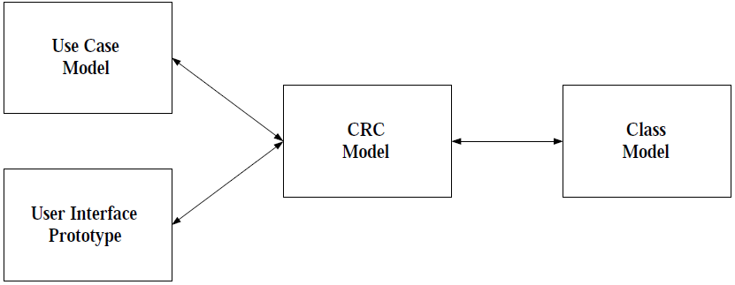
How CRC Modeling Fits in?

Slide 42
CRC Modeling Tips and Techniques
Send ahead an agenda a few days before the modeling session
Prominently display the CRC definitions(etc. responsibility, collaboration)
Use their terminology
Keep it low tech
Expect to prototype
Expect to take a few days
Get management support
Include CRC modeling in your system development life cycle
Do CRC modeling with front-line staff only

Slide 43
Advantages of CRC Modeling
The experts do the analysis
User participation increased
Breaks down communication barriers
It’s simple and straightforward
It’s non-threatening to users
It’s inexpensive and portable
It goes hand-in-hand with prototyping
It leads directly into class diagramming

Slide 44
Disadvantages of CRC Modeling
It’s threatening to some developers
It’s hard to get users together
CRC cards are limited

Slide 45
Inception
Elicitation
Elaboration
Negotiation
Specification
Validation
Requirements
Management

Slide 46
Negotiation Task
During negotiation, the software engineer reconciles the conflicts between what the customer wants and what can be achieved given limited business resources
Requirements are ranked (i.e., prioritized) by the customers, users, and other stakeholders
Risks associated with each requirement are identified and analyzed
Rough guesses of development effort are made and used to assess the impact of each requirement on project cost and delivery time
Using an iterative approach, requirements are eliminated, combined and/or modified so that each party achieves some measure of satisfaction

Slide 47
Art of Negotiation
Recognize that it is not competition
Map out a strategy
Listen actively
Focus on the other party’s interests
Don’t let it get personal
Be creative
Be ready to commit

Slide 48
Inception
Elicitation
Elaboration
Negotiation
Specification
Validation
Requirements
Management

Slide 49
Specification Task
A specification is the final work product produced by the requirements engineer
It is normally in the form of a software requirements specification
It serves as the foundation for subsequent software engineering activities
It describes the function and performance of a computer-based system and the constraints that will govern its development
It formalizes the informational, functional, and behavioral requirements of the proposed software in both a graphical and textual format

Slide 50
Typical Contents of a Software Requirements Specification
Requirements
Required states and modes
Software requirements grouped by capabilities (i.e., functions, objects)
Software external interface requirements
Software internal interface requirements
Software internal data requirements
Other software requirements (safety, security, privacy, environment, hardware, software, communications, quality, etc.)
Design and implementation constraints
Qualification provisions to ensure each requirement has been met
Demonstration, test, analysis, inspection, etc.
Requirements traceability
Trace back to the system or subsystem where each requirement applies

Slide 51
Software Requirements Specification (SRS) template
TABLE OF CONTENTS 1.0 Introduction
1.1 Purpose 1.2 Scope 1.3 Definitions, Acronyms, and Abbreviations 1.4 References 1.5 Overview
2.0 General Description
2.1 Product Perspective 2.2 Product Functions 2.3 User Characteristics 2.4 General Constraints 2.5 Assumptions and Dependencies

Slide 52
SRS template
3.0 Specific Requirements
3.1 Functional Requirements
3.1.1 Unit Registration 3.1.2 Retrieving and Displaying Unit Information 3.1.3 Report Generation 3.1.4 Data Entry
3.2 Design Constraints
3.3 Non-Functional Requirements
3.3.1 Security
Appendix A

Slide 53
SRS explained
1.0 INTRODUCTION
This document specifies all the requirements for
1.1 Purpose
The purpose of the …is to ….
The system should assist ….
The intended audience for this document is …
This specification describes …..
1.2 Scope
This document applies only to …...
This specification is not concerned with …..

Slide 54
SRS explained
1.3 Definitions, Acronyms, and Abbreviations
SRS - Software Requirements Specifications
IEEE - Institute of Electrical and Electronic Engineering
1.4 Reference
[1] IEEE 830-1993: IEEE Recommended Practice for Software Requirements Specifications" IEEE Standards Collection, IEEE, 1997.
1.5 Overview
In the following sections of this specification……will be presented.
In Section 2, the general product and its functions will be introduced.
In Section 3, all detailed requirements will be specified and grouped.
In Appendix …….

Slide 55
SRS explained
2.0 GENERAL DESCRIPTION
2.1 Product Perspective
This system allows stakeholders to…..
The system will display…..
The system will help ……
The system provides information about ….
2.2 Product Functions
The system provides the following functions:

Slide 56
SRS explained
2.3 User Characteristics
The users of the system are:
Level of Users’ Computer Knowledge
Level of Users’ Business Knowledge
Frequency of Use
2.4 General Constraints
The system will support ….
The system will not allow ……
2.5 Assumption and Dependencies
This system relies on ……
The system must have a satisfactory interface and ……

Slide 57
Section 3 of SRS
3 SPECIFIC REQUIREMENTS
3.1 Functional Requirements
3.1.1 Unit Registration
The unit registration requirements are concerned with functions regarding unit registration which includes students selecting, adding, dropping, and changing a unit.
SRS-001 (3.1.1.1):
The system shall allow the user to register a unit.
SRS-002 (3.1.1.2):
STS shall allow the user to delete a unit if the user has chosen to drop that unit.
SRS-003 (3.1.1.3):
STS shall check if a unit has been filled by enough registered students.

Slide 58
SRS functional e.g
SRS-004 (3.1.1.4):
STS shall allow the user to add his/her name to the unit waiting list if the user wants to register in a unit which has been filled already with enough registered students.
SRS-005 (3.1.1.5):
STS shall automatically register the unit for the user who is the first one on the waiting list if a vacancy appears for that unit.
SRS-006 (3.1.1.6):
STS shall allow the user to change practical session(s) within a unit.
SRS-007 (3.1.1.7):
STS shall allow the user to change tutorial session(s) within a unit.

Slide 59
Functional parent reqs broken into many child-reqs.
3.1.2 Retrieving and Displaying Unit Information
The retrieving and displaying requirements are concerned with how information is retrieved and presented to the user.
SRS-014 (3.1.2.1):
The system shall allow users to enter the following selection criteria to retrieve unit information: by unit code, by unit number, by title of unit, by weight of unit (credit points).
OR by unit code (3.1.2.1.1) , by unit number (3.1.2.1.2) , by title of unit (3.1.2.1.3) , by weight of unit (credit points) (3.1.2.1.4).

Slide 60
Design Constraints (3.2)
3.2 Design Constraints
SRS-031 (3.2.1):
STS shall store and retrieve persistent data.
SRS-032 (3.2.2):
STS shall support PC and/or UNIX platforms.
SRS-033 (3.2.3):
STS shall be developed using the JAVA programming language

Slide 61
Non-functional requirements
3.3 Non-Functional Requirements
SRS-034 (3.3.1):
STS shall respond to any retrieval in less than 5 seconds.
SRS-035 (3.3.2):
STS shall generate a report within 1 minute.
SRS-036 (3.3.3):
STS shall allow the user to remotely connect to the system.
SRS-041 (3.3.8):
The system shall be accompanied by a comprehensive user manual.

Slide 62
Safety and security issues
3.5.3 Security
The security requirements are concerned with security and privacy issues.
SRS-029:
VSS shall provide staff ID and password verification protection to protect from unauthorised use of the system.
SRS-030:
VSS shall allow the store manager to add, remove and modify staff ID and passwords as required.

Slide 63
Other SRS template for section 3
3. Specific Requirements
3.1 External Interface Requirements
3.1.1 User Interfaces
3.1.2 Hardware Interfaces
3.1.3 Software Interfaces
3.1.4 Communication Interfaces
3.2 Functional Requirements
3.2.1 Requirement 1
3.2.1.1 Introduction
3.2.1.2 Inputs
3.2.1.3 Processing
3.2.1.4 Outputs
3.2.2 Requirement 2 …..

Slide 64
Other SRS template for section 3
3.3 Performance Requirements
3.4 Design Constraints
3.4.1 Standards Compliance
3.4.2 Hardware Limitations ……
3.5 Software System Attributes
3.5.1 Reliability
3.5.2 Availability
3.5.3 Security
3.5.4 Maintainability
3.5.5 Portability
3.5.6 Reusability
3.5.7 Usability 3.5.8 Other Factors …..
3.6 Other Requirements
3.6.1 Database
3.6.2 Operations …..

Slide 65
Inception
Elicitation
Elaboration
Negotiation
Specification
Validation
Requirements
Management

Slide 66
Validation Task
During validation, the work products produced as a result of requirements engineering are assessed for quality
The specification is examined to ensure that
all software requirements have been stated unambiguously
inconsistencies, omissions, and errors have been detected and corrected
the work products conform to the standards established for the process, the project, and the product
The formal technical review serves as the primary requirements validation mechanism
Members include software engineers, customers, users, and other stakeholders

Slide 67
Questions to ask when Validating Requirements
Is each requirement consistent with the overall objective for the system/product?
Have all requirements been specified at the proper level of abstraction? That is, do some requirements provide a level of technical detail that is inappropriate at this stage?
Is the requirement really necessary or does it represent an add-on feature that may not be essential to the objective of the system?
Is each requirement bounded and unambiguous?
Does each requirement have attribution? That is, is a source (generally, a specific individual) noted for each requirement?
(more on next slide)

Slide 68
Questions to ask when Validating Requirements (continued)
Do any requirements conflict with other requirements?
Is each requirement achievable in the technical environment that will house the system or product?
Is each requirement testable, once implemented?
Approaches: Demonstration, actual test, analysis, or inspection
Does the requirements model properly reflect the information, function, and behavior of the system to be built?
Has the requirements model been “partitioned” in a way that exposes progressively more detailed information about the system?

Slide 69
Inception
Elicitation
Elaboration
Negotiation
Specification
Validation
Requirements
Management

Slide 70
Requirements Management Task
During requirements management, the project team performs a set of activities to identify, control, and track requirements and changes to the requirements at any time as the project proceeds
Each requirement is assigned a unique identifier
The requirements are then placed into one or more traceability tables

Slide 71
Requirements Management Task
These tables may be stored in a database that relate features, sources, dependencies, subsystems, and interfaces to the requirements
A requirements traceability table is also placed at the end of the software requirements specification

Slide 72
Summary
Inception
Elicitation
Elaboration
Negotiation
Specification
Validation
Requirements
Management
☺

Slide 73
Any Question?

